Slide 1


Mid-Term Stochastic Modeling of Energy Markets
and its Applications
Eina Ooka
June, 2018

Slide 2

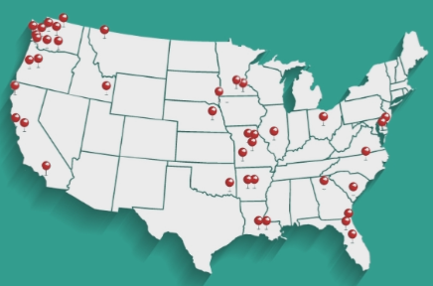
Power Utility Industry
The Energy Authority serves public utilities nationwide for trading and analytics.
Mid-term (1 month – 5 years) portfolio management.
Stochastic simulation models for energy and gas market.

Slide 3
Types of Energy Portfolio Models
Short-Term (ST)
Mid-Term
Long-Term (LT)
15 min ~ A few weeks
1 months ~ several years
A few decades
System Operations
Scheduling
RT/DA Trading
Budgeting
Trading/Hedging
LT planning
Investment and divestitures
Policy development
Operational must- haves
Optional
Regulatory must- haves

Slide 4


Traditional Approach to Mid-Term Modeling
Use commercially available cost-production models
Many utilities already have ST and TL models. Utilize those for mid-term modeling by simply adjusting the simulation time.
Some cost-production models
Focus only on particular resource dispatches. In these models, power prices are often generated by a simple random variable generator.
Too simplistic and cannot capture the time series behaviors.
Are system optimization models that generate power prices as a result of system-wide grid simulation.
Can be too sensitive to small changes and takes too long to run. For active trading purposes, it’s too slow.
Solution
Statistical simulation
Right after wholesale energy market restructuring, cost-production model made sense. But we have gotten enough historical data for building robust statistical model now.

Slide 5
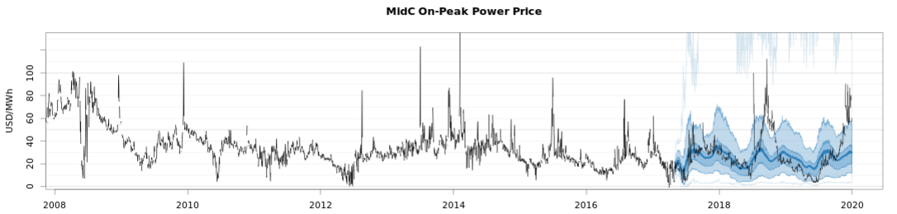
Power Price TS Characteristics
Autocorrelation
Seasonal and weekly shapes
Volatility & Heteroscedasticity
Seasonal and weekly variability
Multivariate cross-correlation and non-linear dependency
NG, load, regional hydro and other variable generation
Non-normal distributions
fat tails
Extreme peaks and drops
Negative prices
Consistency with market expectations
Consistency among different time granularities.

Slide 6
Power Price TS Characteristics
Bootstrapping?
Autoregressive models?
Autocorrelation
Seasonal and weekly shapes
Volatility & Heteroscedasticity
Seasonal and weekly variability
Multivariate cross-correlation and non-linear dependency
NG, load, regional hydro and other variable generation
Non-normal distributions
fat tails
Extreme peaks and drops
Negative prices
Consistency with market expectations
Consistency among different time granularities.
Adjustment?
Transformation? GARCH? Heston?
VARX? MLR? Non-linear models?
Temporal hierarchical model?

Slide 7
1. Data Scraping
2. Dependency Detection
3. Multiplicative Decomposition
HedgeFox
4. Daily Volatility & Spike Model
Monte Carlo Simulation of energy markets and portfolios
5. Long-Term Stochastic Forecasting
6. Disaggregation and Combination
7. Judgmental Adjustment
8. Predictive Modeling
9. Hourly-Shape Analysis
10. Resource Dispatch
11. Cash Flow Aggregation
12. Scenario & Hedge Analysis

Slide 8
1. Data Scraping
2. Dependency Detection
3. Multiplicative Decomposition
HedgeFox
4. Daily Volatility & Spike Model
5. Long-Term Stochastic Forecasting
6. Disaggregation and Combination
7. Judgmental Adjustment
Power Price Simulation
8. Predictive Modeling
9. Hourly-Shape Analysis
10. Resource Dispatch
11. Cash Flow Aggregation
12. Scenario & Hedge Analysis

Slide 9
1. Data Scraping
Daily Stochastic Data
are decomposed and simulated.
- Loads
- Hydro & variable generations
- Natural gas prices
2. Dependency Detection
3. Multiplicative Decomposition
HedgeFox
4. Daily Volatility & Spike Model
5. Long-Term Stochastic Forecasting
6. Disaggregation and Combination
7. Judgmental Adjustment
Power Price Simulation
8. Predictive Modeling
9. Hourly-Shape Analysis
10. Resource Dispatch
11. Cash Flow Aggregation
12. Scenario & Hedge Analysis

Slide 10
1. Data Scraping
Daily Stochastic Data
are decomposed and simulated.
- Loads
- Hydro & variable generations
- Natural gas prices
2. Dependency Detection
3. Multiplicative Decomposition
HedgeFox
4. Daily Volatility & Spike Model
Monthly LT Forecasts are simulated or imported and daily data are adjusted accordingly.
- Forward prices
- External load and hydro forecast
5. Long-Term Stochastic Forecasting
6. Disaggregation and Combination
7. Judgmental Adjustment
Power Price Simulation
8. Predictive Modeling
9. Hourly-Shape Analysis
10. Resource Dispatch
11. Cash Flow Aggregation
12. Scenario & Hedge Analysis

Slide 11
1. Data Scraping
Daily Stochastic Data
are decomposed and simulated.
- Loads
- Hydro & variable generations
- Natural gas prices
2. Dependency Detection
3. Multiplicative Decomposition
HedgeFox
4. Daily Volatility & Spike Model
Monthly LT Forecasts are simulated or imported and daily data are adjusted accordingly.
- Forward prices
- External load and hydro forecast
5. Long-Term Stochastic Forecasting
6. Disaggregation and Combination
7. Judgmental Adjustment
Power Price Simulation
Daily
8. Predictive Modeling
are derived from simulated daily data
- Major power Hub
- Other LMPs as price differentials
9. Hourly-Shape Analysis
10. Resource Dispatch
11. Cash Flow Aggregation
12. Scenario & Hedge Analysis

Slide 12
1. Data Scraping
Daily Stochastic Data
are decomposed and simulated.
- Loads
- Hydro & variable generations
- Natural gas prices
2. Dependency Detection
3. Multiplicative Decomposition
HedgeFox
4. Daily Volatility & Spike Model
Monthly LT Forecasts are simulated or imported and daily data are adjusted accordingly.
- Forward prices
- External load and hydro forecast
5. Long-Term Stochastic Forecasting
6. Disaggregation and Combination
7. Judgmental Adjustment
Power Price Simulation
Daily
8. Predictive Modeling
are derived from simulated daily data
- Major Power Hub
- Other LMPs as price differentials
Hourly Resource Simulation
9. Hourly-Shape Analysis
10. Resource Dispatch
Hourly adder shape classification
11. Cash Flow Aggregation
12. Scenario & Hedge Analysis

Slide 13
1. Data Scraping
Daily Stochastic Data
are decomposed and simulated.
- Loads
- Hydro & variable generations
- Natural gas prices
2. Dependency Detection
3. Multiplicative Decomposition
HedgeFox
4. Daily Volatility & Spike Model
Monthly LT Forecasts are simulated or imported and daily data are adjusted accordingly.
- Forward prices
- External load and hydro forecast
5. Long-Term Stochastic Forecasting
6. Disaggregation and Combination
7. Judgmental Adjustment
Power Price Simulation
Daily
8. Predictive Modeling
are derived from simulated daily data
- Major Power Hub
- Other LMPs as price differentials
Hourly Resource Simulation
9. Hourly-Shape Analysis
10. Resource Dispatch
Hourly adder shape classification
11. Cash Flow Aggregation
12. Scenario & Hedge Analysis
Monthly aggregation into portfolio cash flow

Slide 14
1. Data Scraping
2. Dependency Detection
3. Multiplicative Decomposition
HedgeFox
4. Daily Volatility & Spike Model
5. Long-Term Stochastic Forecasting
6. Disaggregation and Combination
7. Judgmental Adjustment
Power Price Simulation
8. Predictive Modeling
9. Hourly-Shape Analysis
10. Resource Dispatch
11. Cash Flow Aggregation
12. Scenario & Hedge Analysis

Slide 15
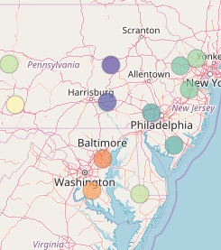
Power Price Simulation
Simulate multiple prices as price differentials to one major hub price.
Feature space
Autoregressive terms
Month and Day-of-Week
Already simulated fundamentals such as solar, wind & hydro generation, gas prices and multiple loads
Power price series at a major hub
All other LMP price differential simulated prior to the particular LMP
Feature space may not include all price drivers.

Slide 16
Common Approach for Stochastic Modeling
𝑃𝑟𝑖𝑐𝑒=𝑓(…)+𝐸𝑟𝑟𝑜𝑟(…)
Where 𝑓 is some sort of regression model
Requirements for the residuals
Normal distribution
𝑓’s features need to include enough information
Need careful examinations of error terms for each variables.
If requirements are met, the correct level of volatility should be captured automatically, but otherwise, volatility may not match.
We need something robust for the error terms.

Slide 17
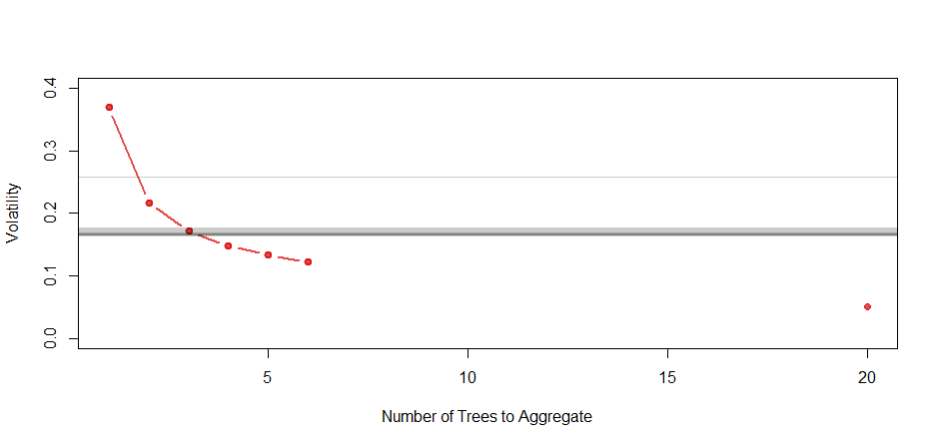
Bunched Random Forest
Random Forest
Aggregation of a few hundred trees moderate values too much → Low volatility
a single tree encompasses too little predictability → High volatility
Bunched RF in MC
Aggregating a selected number of trees for each Monte Carlo iteration
Achieve plausible volatility in each MC series, while maintaining the same predictability as RF in the whole MC simulation.
Implementation
randomForest::predict.randomForest() includes individual tree outputs.
After figuring out the bunching number based on historical volatility, sample and aggregate suitable number of individual tree outputs.
Adjust node sizes if necessary.
Simulated
Historical
… 300

Slide 18
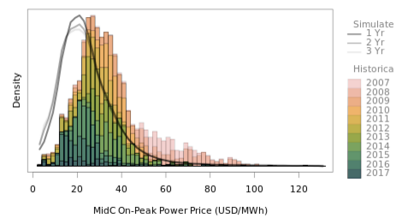
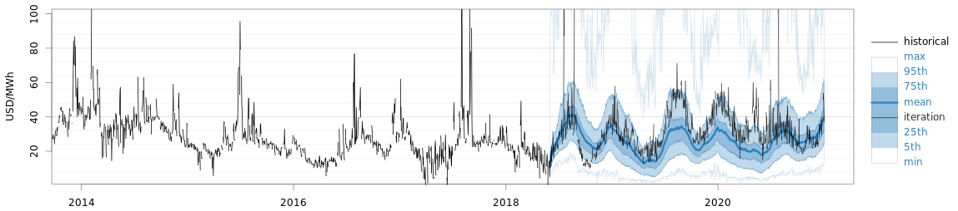
Results
Price distribution (overall and at monthly level).
Price Distribution
Mid-C Power Price (Historical + Simulated)

Slide 19
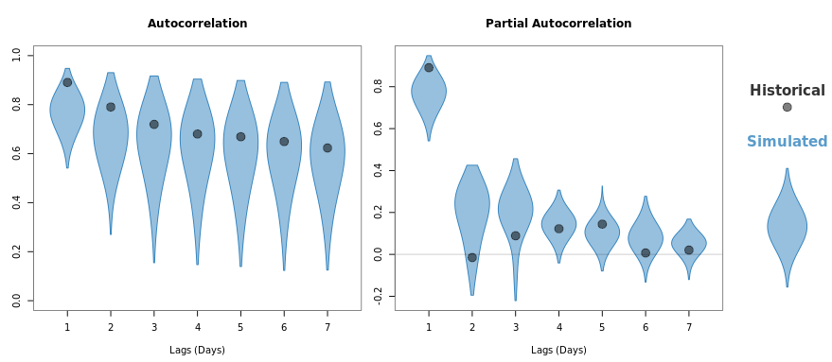
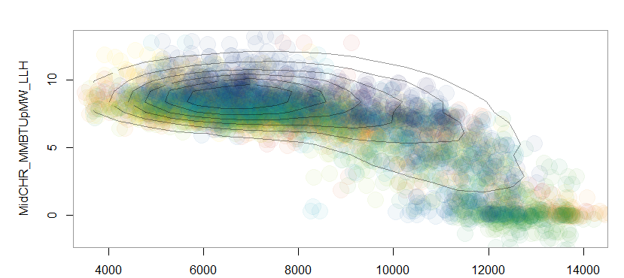
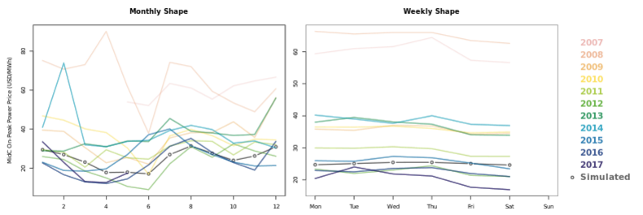
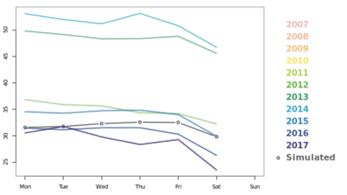
Results
Autocorrelation
Seasonal Shapes
Weekly shapes
Non-linear dependencies
MidC Power Heat Rate (mmBtu/MWh)
Seasonality
Weekly Shape
Non-linear dependency on regional hydro
Regional Hydro Generation (aMW)

Slide 20
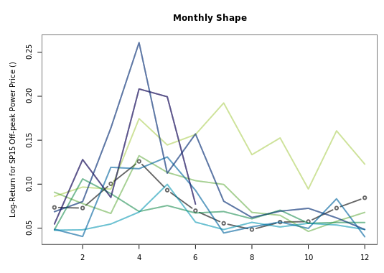
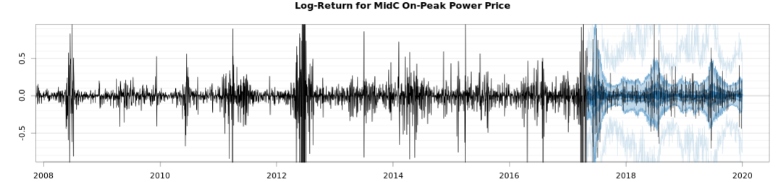
Results
Volatility
Heteroscedasticity
Seasonality
Seasonality in Volatility
Power Price Log-Returns (Historical + Simulated)

Slide 21
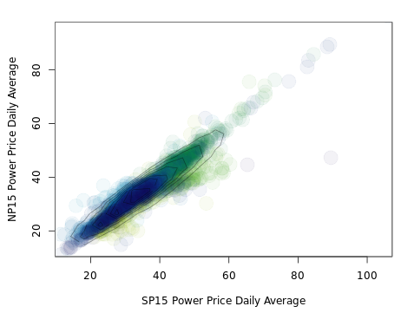
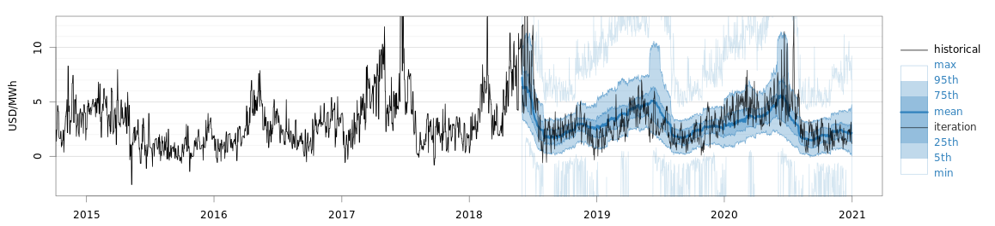
Results
Multivariate cross-correlations
Collinear Power Prices
Price Differential between LMPs

Slide 22
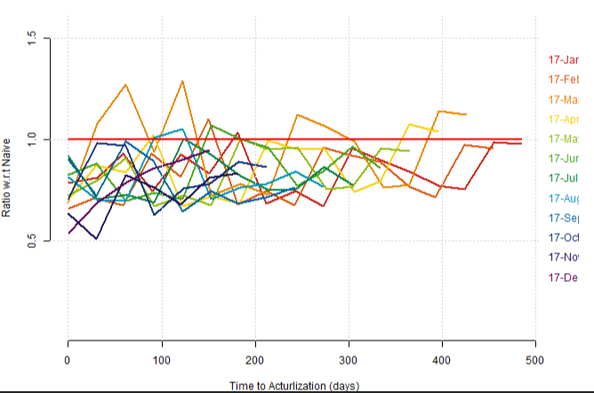
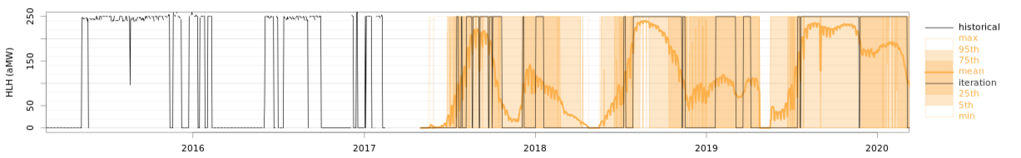
Scoring Methods
In order to make sure that all needed behaviors are captured multiple scoring methods are used.
Volatility
Check is simulated volatility matches with historical.
CRPS against naïve model
Calculate ratio between CRPS of simulated and naïve models
Pinball Loss Score on Resource dispatch simulation outputs
Resource dispatch model transforms power price behavior to cash flow. This combines and checks many of the power price characteristics.
Natural Gas Resource Dispatch (Historical + Simulated)

Slide 23
Summary of BRF
Benefits
No concern about residual behaviors.
Robust in feature space (many collinear variables or too little drivers)
Volatility is automatically adjusted in the process.
Heteroscedasticity is captured.
Variable importance can be insightful in learning the drivers of particular price nodes.
Limitations
Difficult to tune bunching numbers, particularly when a large number of prices are derived sequentially.

Slide 24
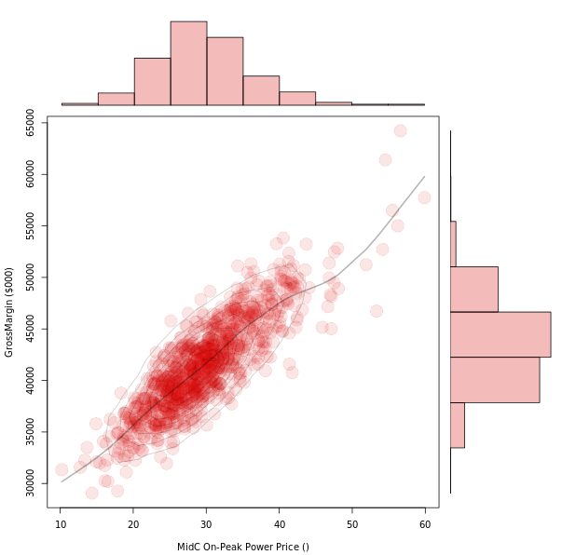
Delta Hedging
Delta is the change in portfolio value with respect to market prices.
Delta neutral is a portfolio strategy where portfolio value remains unchanged when small changes occur in the market.
Some of the risk averting utilities like to manage portfolios actively, and requires a swift market & portfolio model.

Slide 25
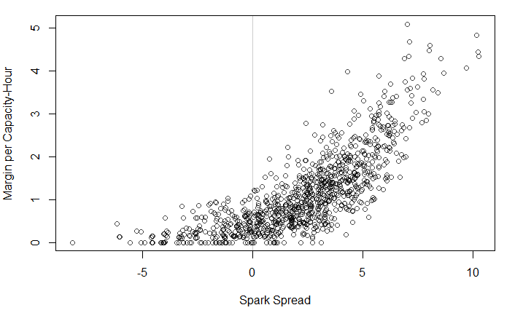
Delta Hedging of a Thermal Unit
Natural gas resources can be treated as a ‘real option’ with respect to spark spread.
Spark Spread = Power Price – (HeatRate x Gas Price + VOM)
Through dynamic delta-hedging, realization of extrinsic value is possible.
Have a market and resource model be always up-to-date.
Watch spark spread and corresponding delta on daily basis.
When market moves, trade heat rate. Unwinding positions should lock in positive cash flow.

Slide 26


My slide can be found at https://github.com
/einaooka
Thank you!
Contact:
eooka@teainc.org
The Energy Authority is looking for an intern.

